Slide 1


Slide 2
Objectives
At the end of this session you will be able to
  Define a web application and its architecture.
  Use basic terminology of web.
  Use JavaScript for interactive web programming.
  Name the two types of web programming.
  List the success factors and challenges of Active Server Pages (ASP) for web application development.
  State how ASP.NET is better than ASP.
Notes:
Describe
Name
List
Use
Compare / contrast

Slide 3
Web Application
Application be able to support a set of thousand users.
Service be available for 24x7x365 .
Internet as environment for hosting application.
Access using internet connectivity
  Net Banking
  Online Shopping portal
  Air Travel Reservation system

Slide 4

Web Application Architecture
PC/Mac/Unix/...
+ Browser
HTTP, TCP/IP
Web Server
Response:
<html>….</html>
Request:
http://www.msn.com/default.asp
Client
Network
Server

Slide 5
Hypertext Transfer Protocol (HTTP)
The top-level protocol used to request and return data
  E.g. HTML pages, GIFs, JPEGs, Microsoft Word documents, Adobe PDF documents, etc.
Request/Response standard between client and server
Stateless protocol
  Each HTTP request is independent of previous and subsequent requests
Methods: GET, POST, …

Slide 6
Hypertext Markup Language (HTML)
Create interactive Web user interface using controls
  Textboxes, buttons, Dropdown Lists, etc.
Rendered and viewed in a Web browser
Web page could contain
  Links to images, documents, and other pages
  Forms for the users to fill required information and submit it.
Form data is sent to the Web server via HTTP when the form is submitted

Slide 7
Scripting Languages
Web page need to be dynamic.
Used to coordinate and combine components that are written in some other language and cannot usually itself be used for writing those components.
  Embedded within HTML to add functionality to web page
    Menu styles
    Graphic display
    Dynamic advertisements
Examples
  JavaScript, VBScript

Slide 8
Web Application Programming
Web based applications are developed using
  Client side Programming
    Software that is downloaded from Web server to browser and then executed on the client
    HTML,DHTML, JavaScript ,VBScript
  Server side Programming
    Software that runs on the server, not the client
    Using technologies like Active Server Pages (ASP), Java Server Pages (JSP), Personal Home Page (PHP),ASP.NET

Slide 9
Active Server Pages (ASP)
Technology to easily create server-side applications
ASP pages are written in a scripting language, usually VBScript or Jscript.
An ASP page contains a sequence of HTML and VBScript code .
A request to ASP page is passed by IIS to ASP engine which interprets the file and sends back plain HTML to client.

Slide 10
ASP - success factors and challenges
Success factors
    Simple procedural programming model
    Access to COM components
    Script-based
    Support for multiple scripting languages
Challenges
    Coding overhead
    Code readability Maintaining page state requires more code
    Reusability is less
    Does not support many browsers
    Session state scalability and availability
    Limited support for caching, tracing, debugging, etc.

Slide 11
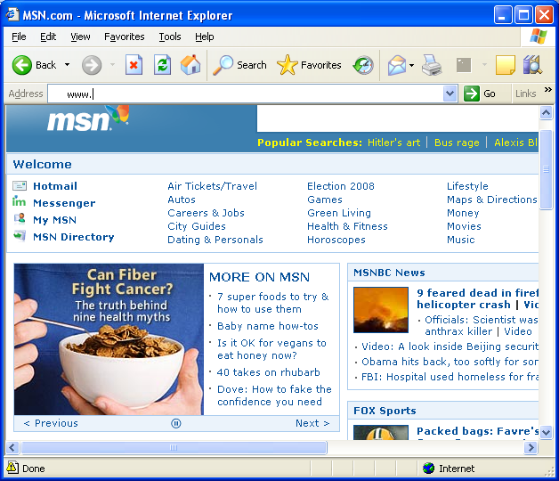
ASP.NET
  ASP.NET is server-side technology that provides services to create, deploy, and execute Web Applications and Web Services.
IIS
request
response
Database Server
Client

Slide 12
Key Features of ASP.NET
Integrated with .NET framework
Built on simple Object-oriented model
Multilanguage support
Multibrowser support
Web Forms and Web Services
Easy to deploy
Security
XML Configuration

Slide 13
Quick Recap . . .
Application that is hosted on web server and accessed using browser with HTTP as the top level protocol for information transfer.
Web Application architecture is based on request response model.
Client side programming involves execution of the script at client side.
Server side programming involves execution of script at server side.
ASP and ASP.NET are technologies to create server side web applications.
These applications are hosted on IIS which is the web server.
ASP.NET provides a number of features for efficient web application development.

